Slide 1
Welcome!
Question of the Day:
‹#›

Slide 2
7.4 Advanced Array Techniques
PROFESSOR RAMSEY
GDC 6.318
ramsey@cs.utexas.edu

Slide 3
Announcements
TBD

Slide 4
Quiz

Slide 5
6.4
Advanced Array Techniques

Slide 6
Array Shift
Solving some problems, like inserting and deleting items in an array, require a shift. This shows a right shift:
index | 0 | 1 | 2 | 3 | 4 | 5 | 6 | 7 | 8 | 9
value | 1 | 0 | 2 | 0 | 0 | 0 | 4 | 1 | 7 | 0
index | 0 | 1 | 2 | 3 | 4 | 5 | 6 | 7 | 8 | 9
value | 0 | 1 | 0 | 2 | 0 | 0 | 0 | 4 | 1 | 7

Slide 7
Demo
Demo 1
Write shiftRight
(Do next slide first.)

Slide 8
Shift Right Manual Solution
index | 0 | 1 | 2 | 3 | 4 | 5 | 6 | 7 | 8 | 9
value | 1 | 0 | 2 | 0 | 0 | 0 | 4 | 1 | 7 | 0
Steps:
Save the last item in temp.
Loop for each item in list, except the first, in reverse order
array[i] = array[i - 1]
Put temp into the first position.

Slide 9
Demo Code

Slide 10
shift() - perform left or right and shift of any size, positive or negative
In-Class Practice
Design
index | 0 | 1 | 2 | 3 | 4 | 5 | 6 | 7 | 8 | 9
value | 1 | 0 | 2 | 0 | 0 | 0 | 4 | 1 | 7 | 0
index | 0 | 1 | 2 | 3 | 4 | 5 | 6 | 7 | 8 | 9
value
Questions
We have shiftRight already. What is shift left?
Handle positive count < length
Handle negative count < length
Handle abs(count) > length
num shifts is abs(size)
loop once for each shift
for positive shift, shift right 1
for negative shift, shift left 1

Slide 11
Method: shift()
Purpose: same as last, but can do left or right and shift of any size, positive or negative
Parameters: array to shift, size of shift (positive is right, negative is left)
Return: none (array returns by default, no return statement)
In-Class Practice
Code
Calling code:

Slide 12
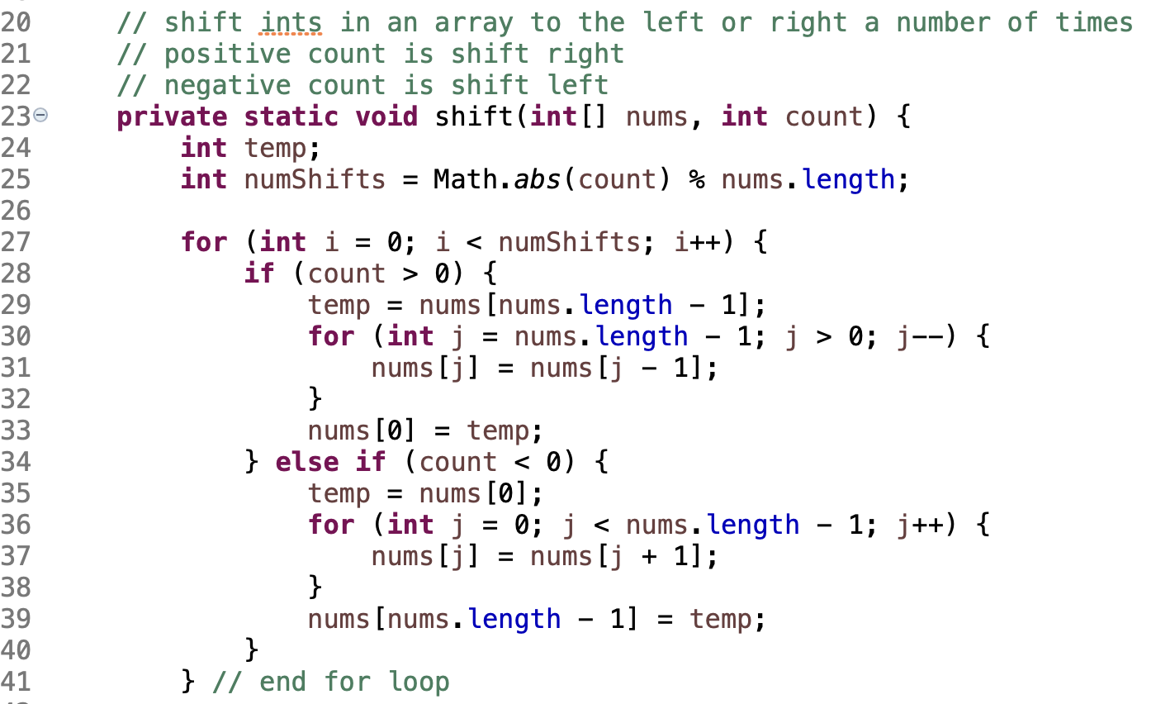
Solution

Slide 13
Manual Solution
In-Class Practice
Design
Steps:
getInversions()- given list of ints, prints pairs of numbers in which the larger number appears earlier in the set than the smaller number.
Start with 2.
Look at numbers to the right to see if they make an inversion with 2: (2, 4), (2, 1) and (2, 3). Only (2, 1) is an inversion.
Looking at 4, repeat step 2.
Looking at 1, repeat step 2.
Don’t do 3, it isn’t possible to have an inversion with the last item.

Slide 14
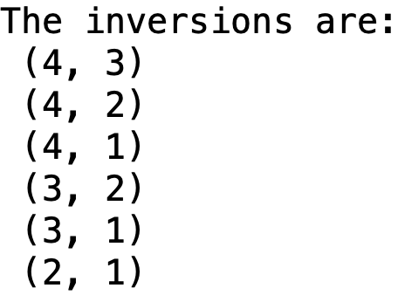
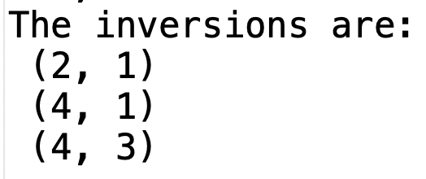
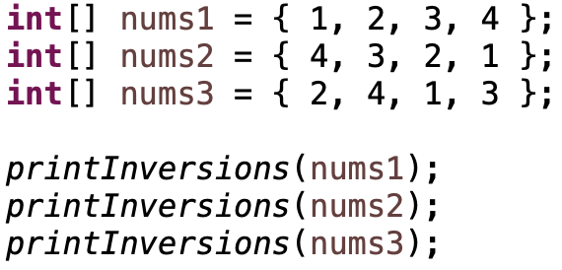
Method: getInversions()
Purpose: given list of ints, prints pairs of numbers in which the larger number appears earlier in the set than the smaller number.
Parameters: array of ints
Return: none (results are printed)
In-Class Practice
Code
Examples:
Calling code:

Slide 15
Solution

Slide 16
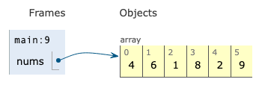
Manual Solution
In-Class Practice
Design
evensBeforeOdds() - Without creating a second array, swap values in an array of ints until all the even numbers occur before odd numbers.
Start i at the beginning of the array
Start j at the end.
Add 1 to i until you find an odd number (a number potentially out of place) or until you reach the end of the array.
Subtract 1 from j until you find an even number or until you read the beginning of array.
If i < j, swap the values.
If i < j, continue.

Slide 17
Method: evensBeforeOdds()
Purpose: Without creating a second array, swap values in an int array until all the even numbers occur before odd numbers.
Parameters: array of ints
Return: none (array returns by default, no return statement)
In-Class Practice
Code
Example:
Calling code:

Slide 18
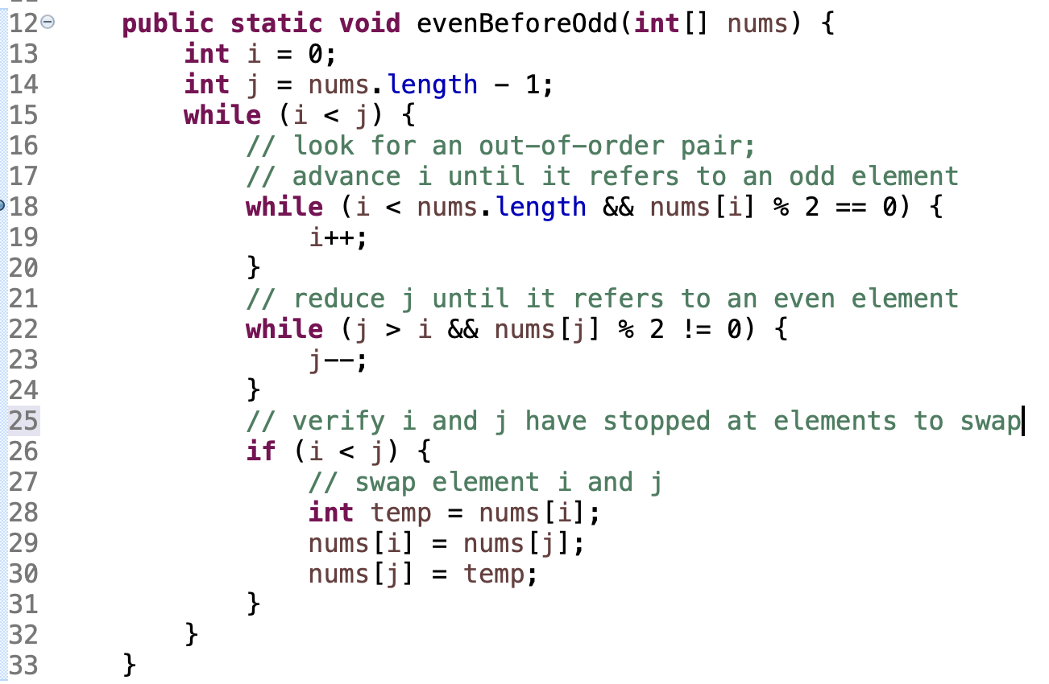
Solution

Slide 19
Remember
You Belong Here
Hi!

